Slide 1
Blackboard Website Remake
Ricardo
Matthew
Umme
Chanesh
Renee

Slide 2
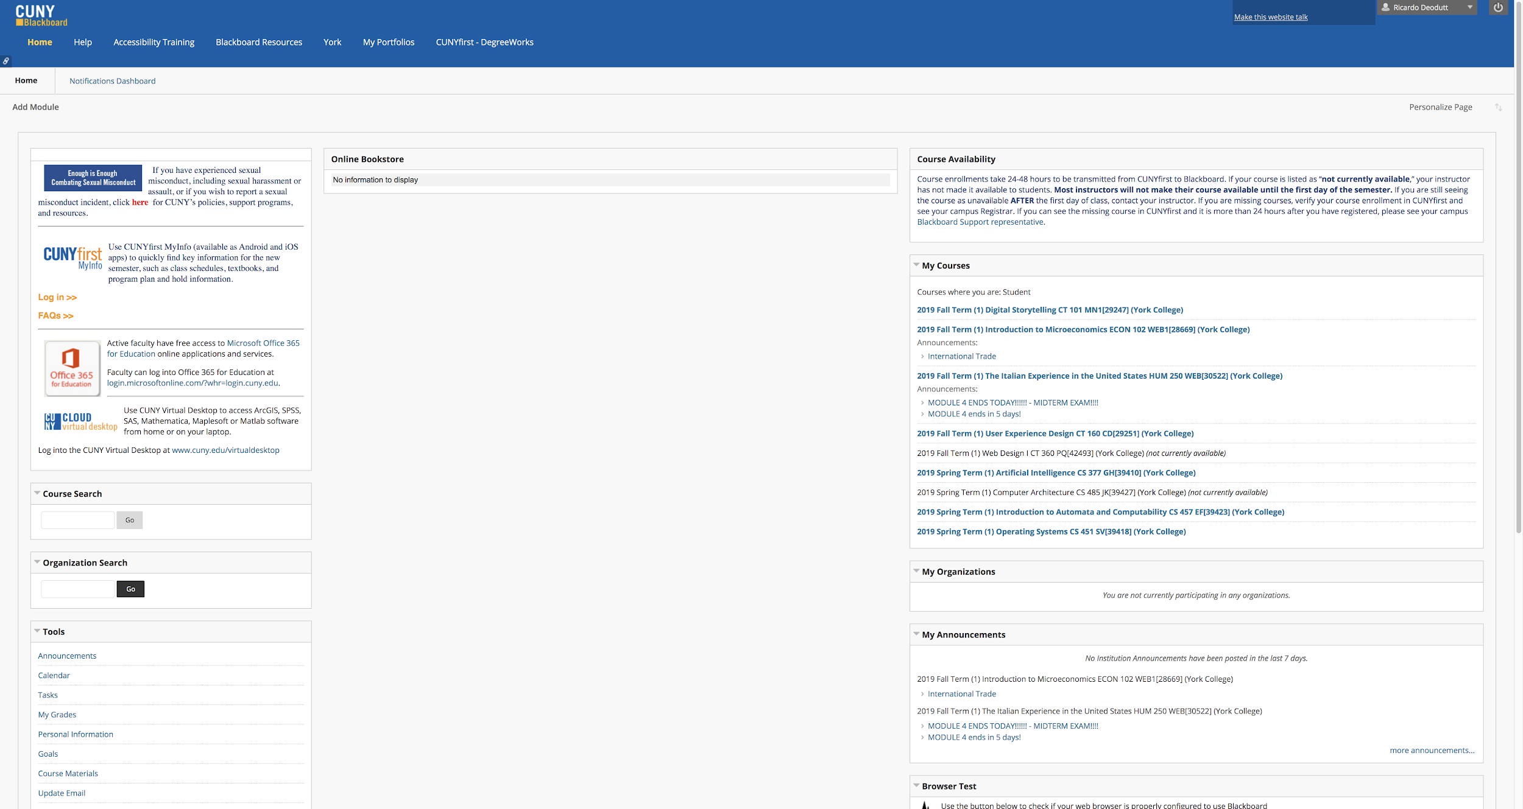
Original Website

Slide 3
Issues with Current Design
Current courses are put in the same list with older courses.
Class names are too long
2019 Fall Term (1) User Experience Design CT 160 CD[29251] (York College)
Lots of empty white space.

Slide 4
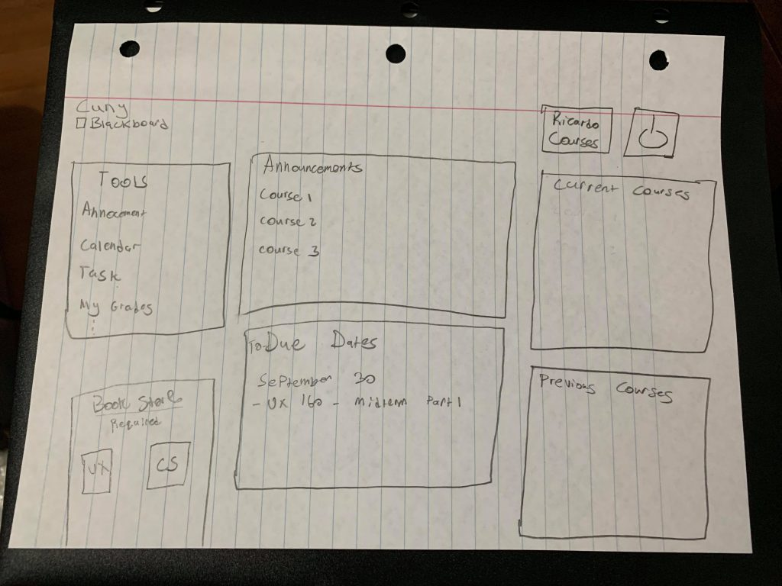
Our Ideas
As a group, our goal is to change Blackboard. Our group wanted to…
Simplify it
Modernize it
Add more Customizable features
The image to the left is our initial plans on how we wanted to lay out the remade website.

Slide 5
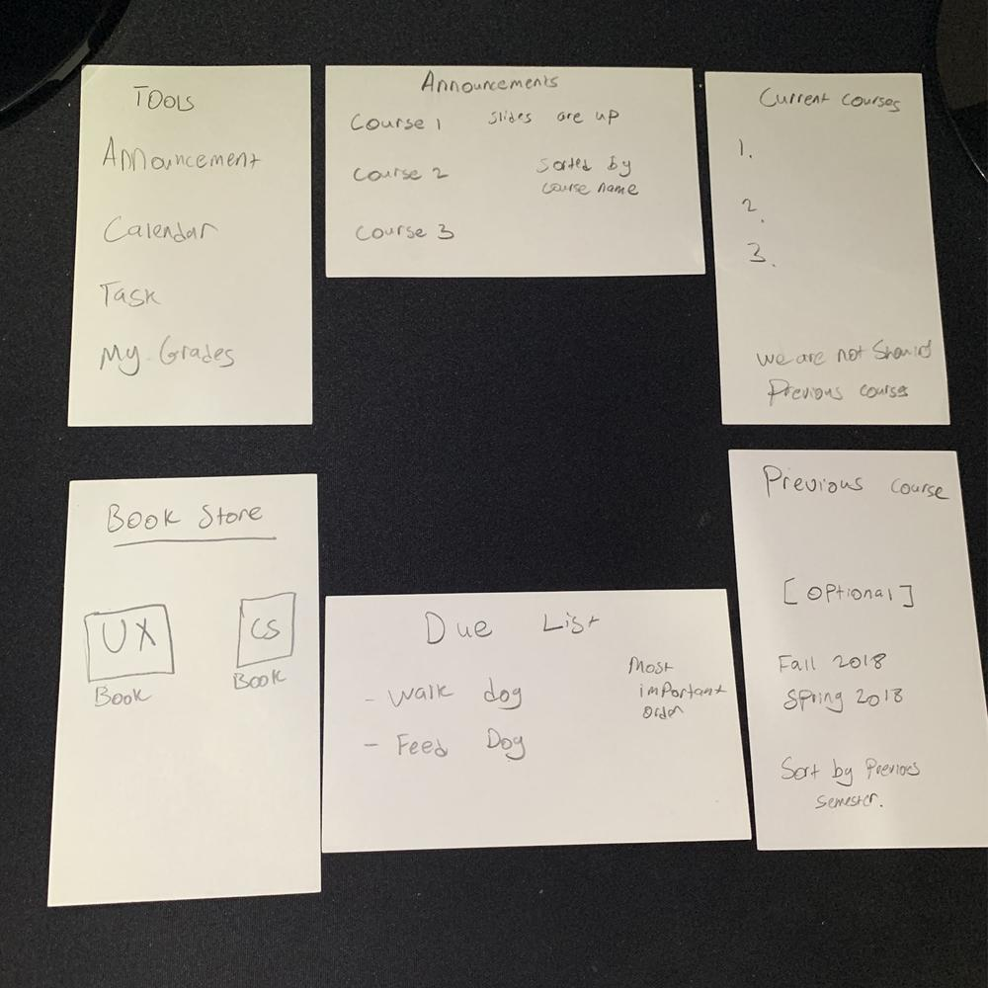
Card Sorting
The following image shows our website layout using index cards.
In this picture, our group briefly talked about LATCH features that we wanted to implement in certain sections.

Slide 6
Survey - Data Results

Slide 7
What's The Demography?
Well, all of our users are students of CUNY so they are all required to use Blackboard and at least be familiar with the idea of Blackboard.
17 users.
College students from York, Queens, John Jay, City, Hunter, NY City Tech, BMCC.
Most of the users are juniors and seniors. Along with some freshman and graduate students.

Slide 8
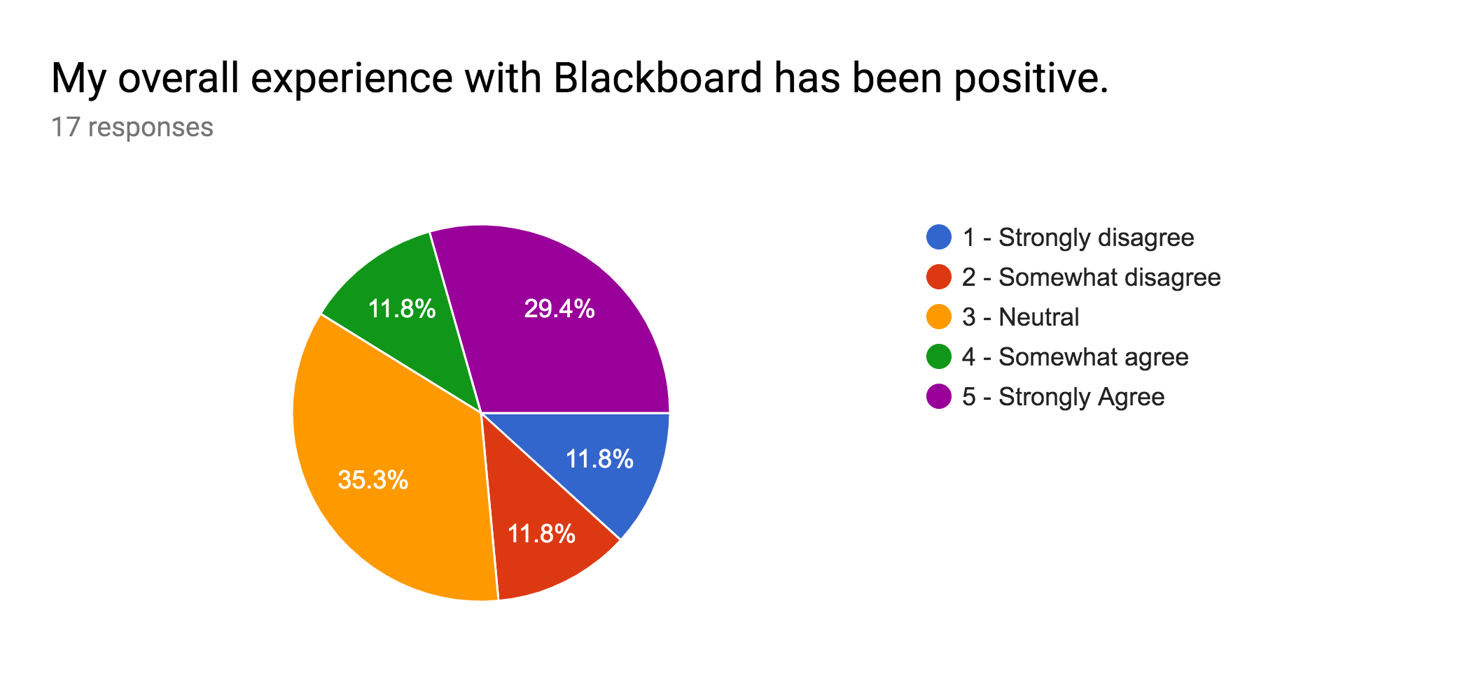

Slide 9
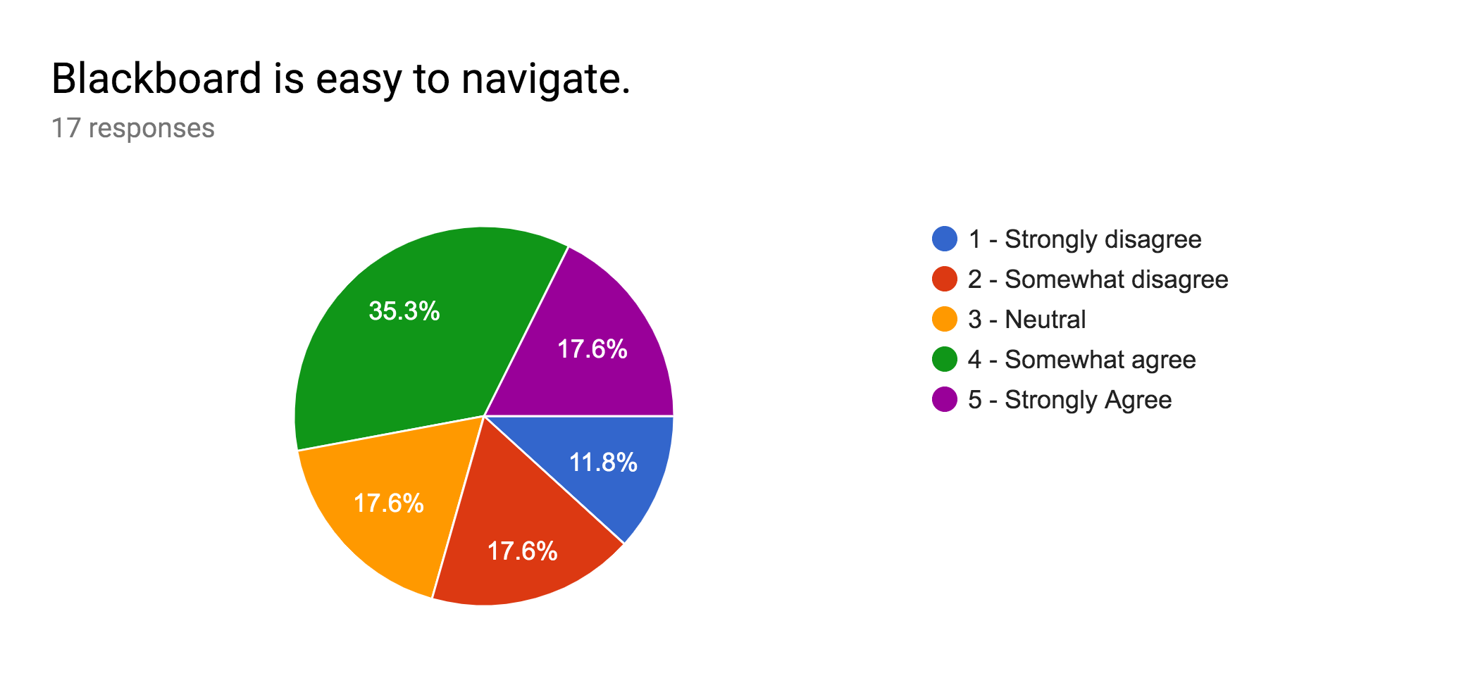

Slide 10
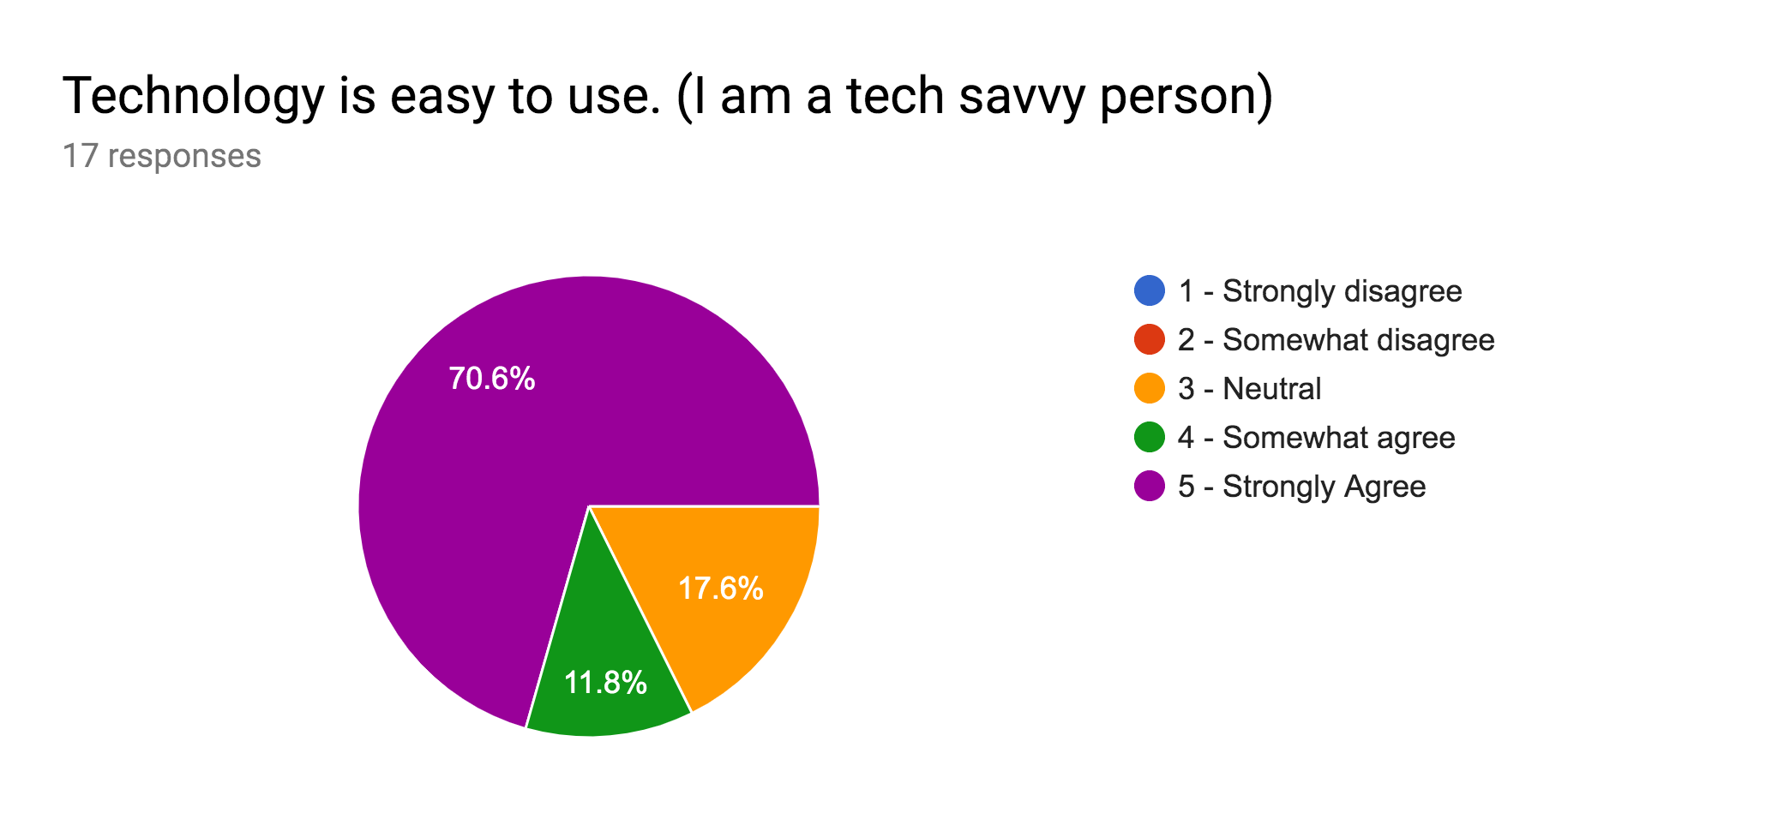

Slide 11
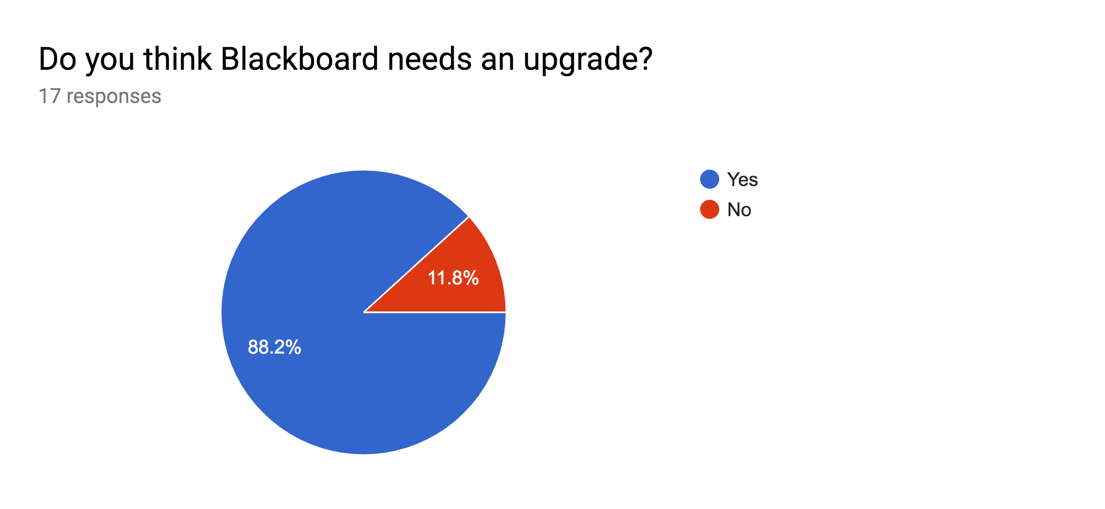

Slide 12
What is the most requested change in Blackboard?
Change the layout style of the course section.
Change to the notification and the status bar.

Slide 13
Notable Responses from Survey
“Take out old previous courses.” - Bishajit L.
“Make notification bar bigger and fill in blank space.” - Matthew H.
“Change colors based on school colors.” - Saurav S.
“Tear the whole thing down and simplify it.” - Md. F.
“Remove useless information and place important parts like my courses on the top of the page.” - Amrit S.

Slide 14
Paper Prototype

Slide 15
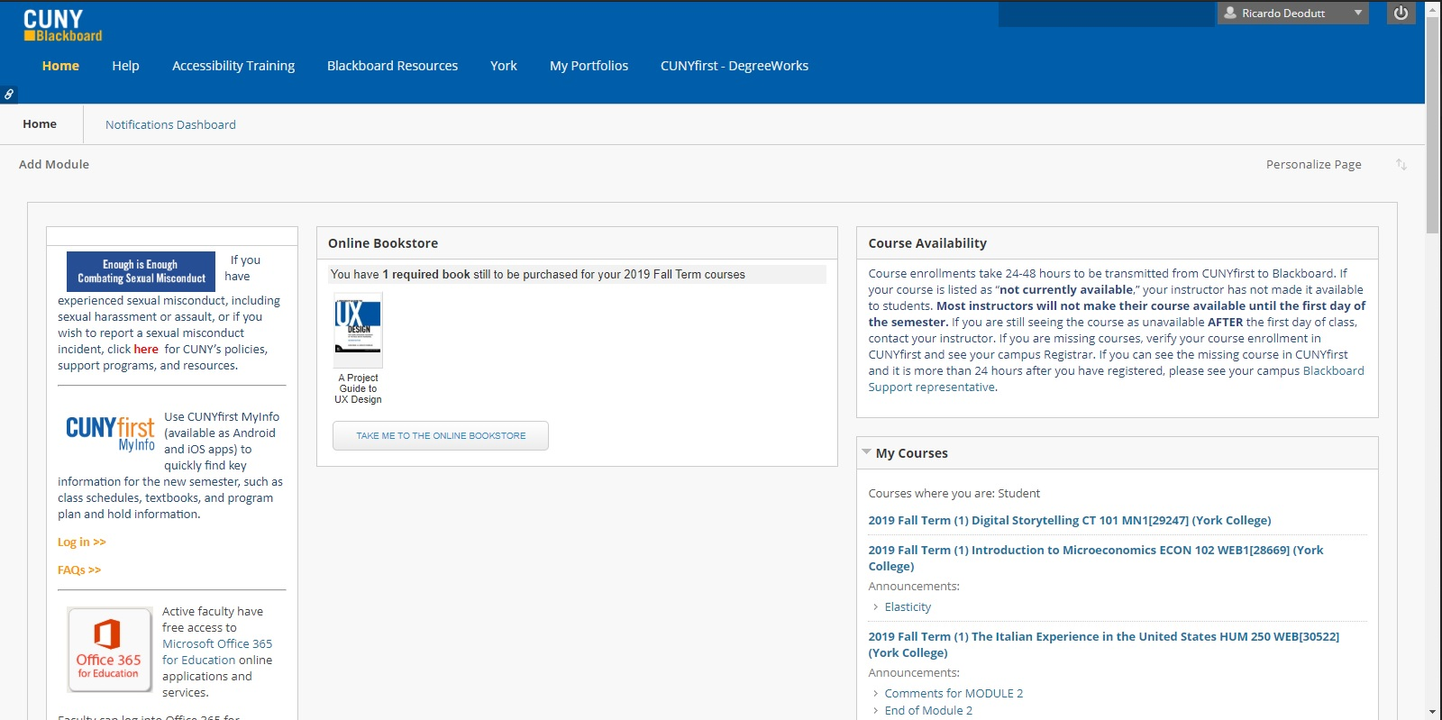
Original Image: Blackboard Home

Slide 16
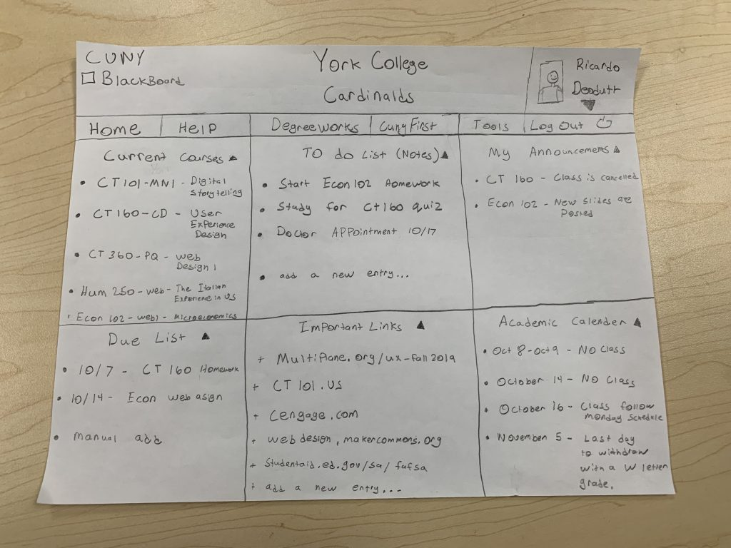
Grid format (no empty spaces), customizable sections, and filtered courses.

Slide 17
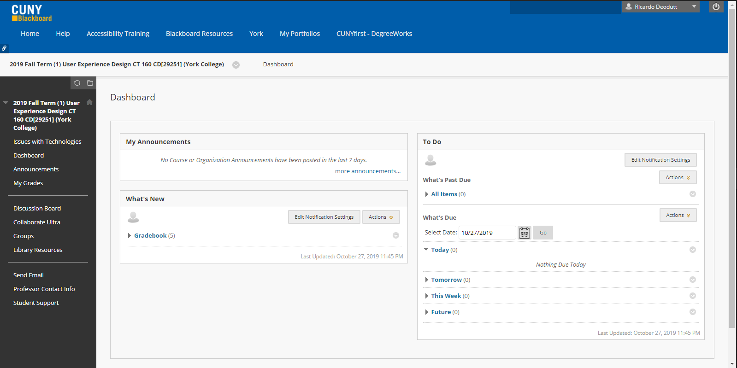
Original Image: Course Dashboard

Slide 18
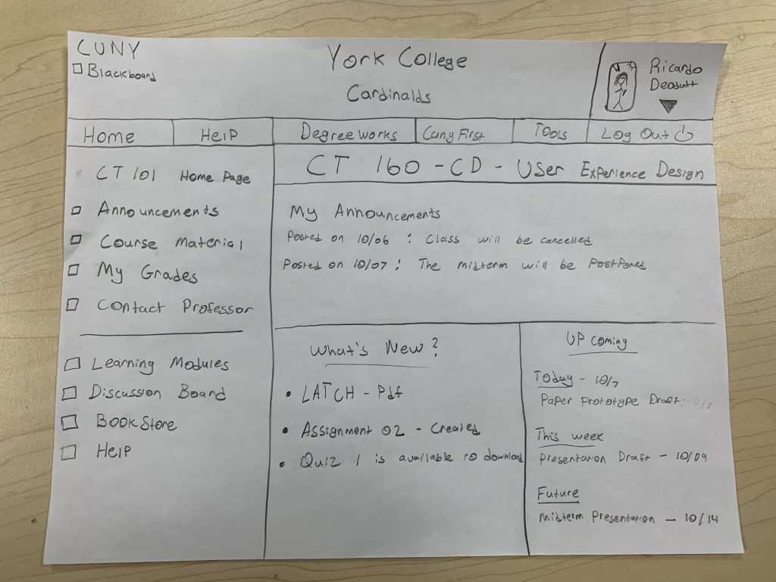
Uniform layout on all courses.

Slide 19
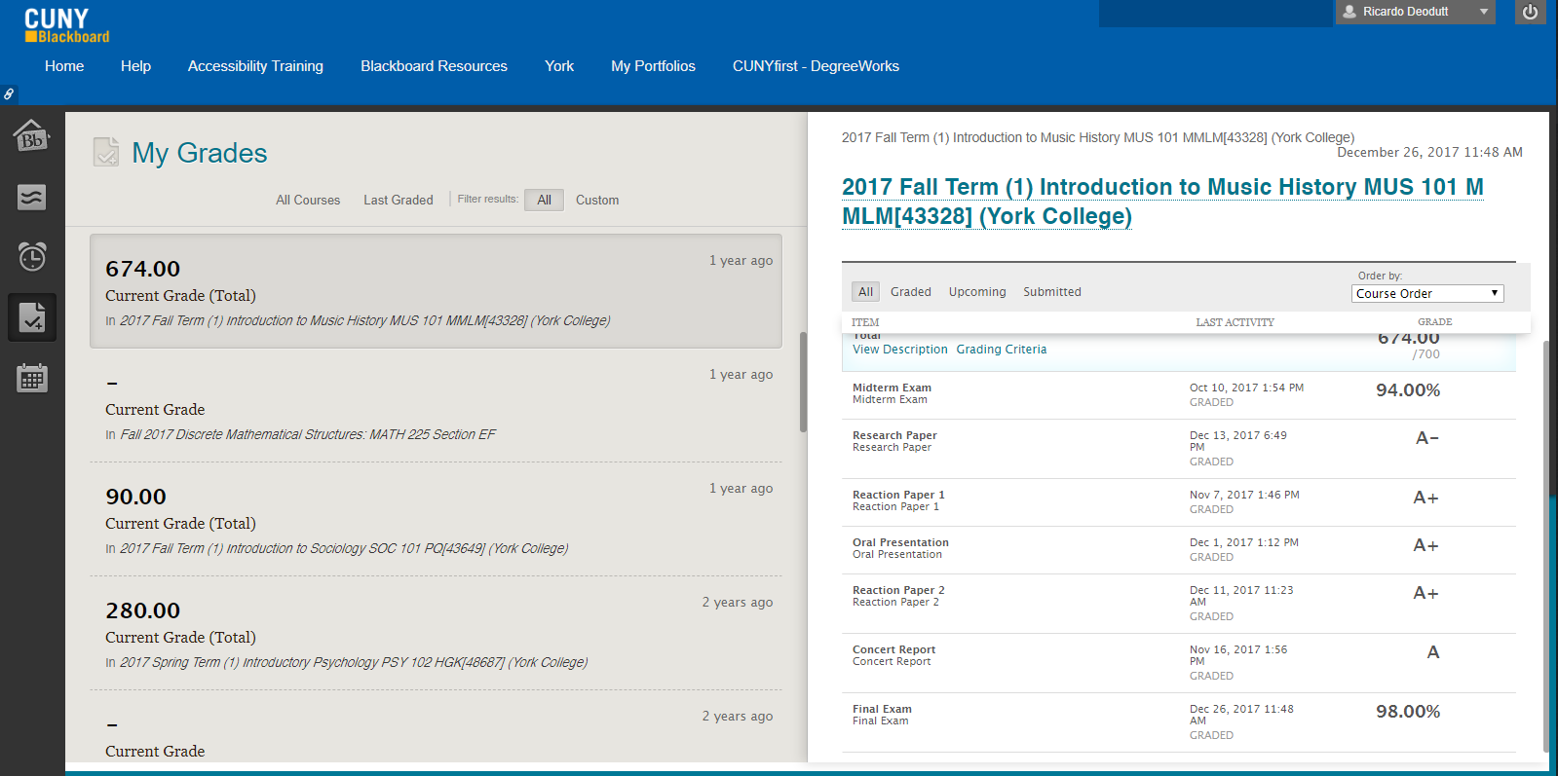
Original Image: Grades Section

Slide 20
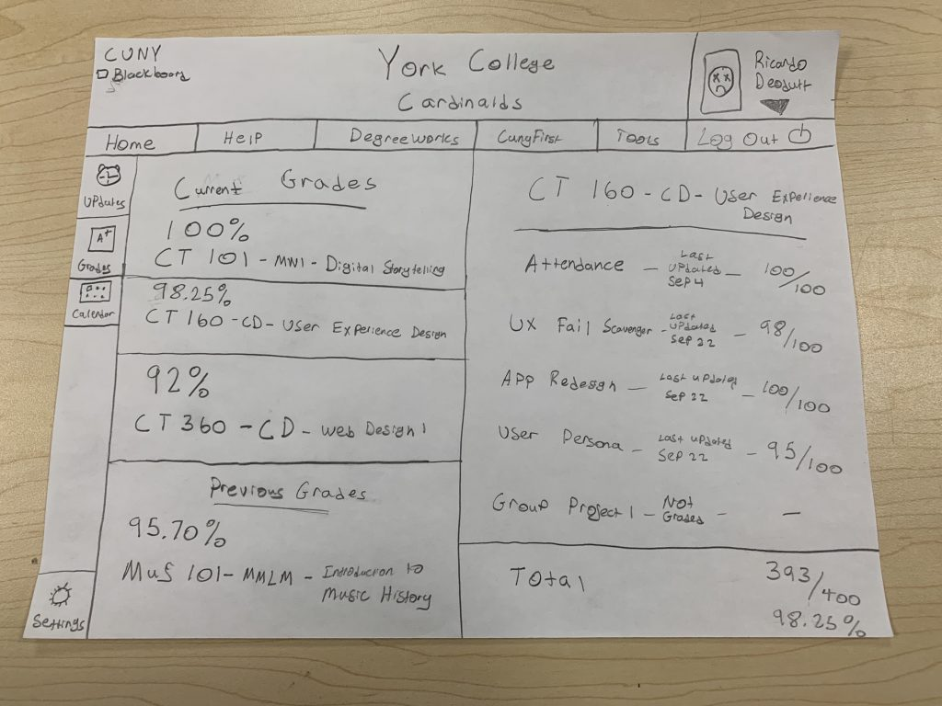
Grades are shown in percentages, and courses are filtered.

Slide 21
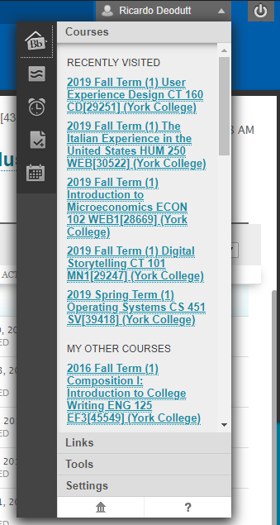
Original Image: Navigation Drop Down

Slide 22
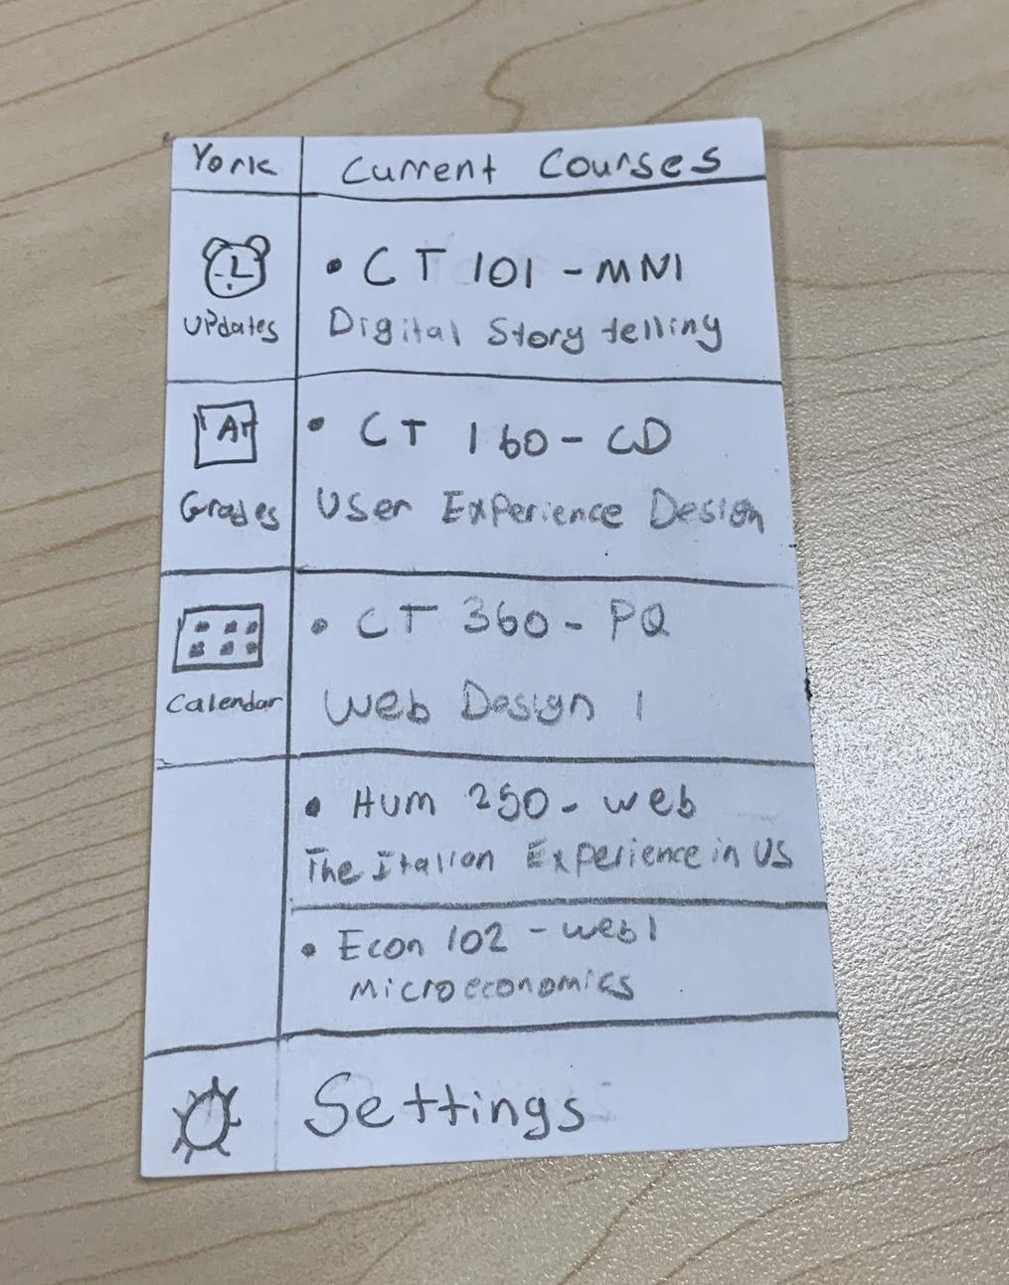
Course names are simplified and courses are filtered.

Slide 23
Notable Responses after Paper Prototype Testing
“I think there is a lot of content on a page, but you know where to go”.- Paragati K.
“A good suggestion is to have a toggle menu for the home page, but overall I liked it”. - Qadeer S.
“Put the help by the logout button”. - Marvin M.
“Have percentages for the grade section”. - Richie C.
“I like how it’s a grid and fills up space. It’s customizable and I feel with the trend right now”. - Professor N.

Slide 24

Link to Adobe XD Design

Slide 25
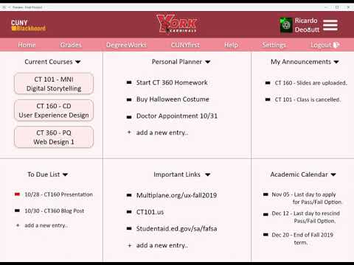
Movie Walkthrough of website

Slide 26
Red Route
Daniel Hernandez is a senior at York College. He wants to check if he is failing his CT160 course. He would find his grades by….
Step 1 – Sign into Blackboard.
Step 2 – Click on CT160 in the current courses section.
Step 3 - Click on My Grades.
Step 4 - Logout.

Slide 27
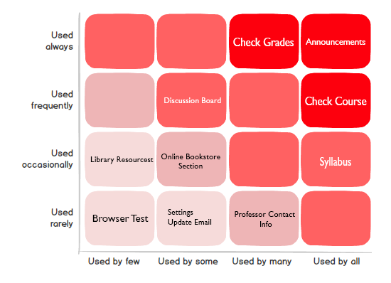
Red Route Matrix

Slide 28
Final Design Analysis
After further testing, our group decided changes were necessary to our design. In our first design prototype, we let our classmates test out our remake and they faced many issues. The main issue was, people did not know what to click on. The designer fixed this by making clickable parts into buttons.
Another tester also recommended that we should add an off-white color to the background. We also fixed that by adding a very light red to fit with our color pallet. The other issues were just minor typos, alignment problems and naming issues. All these issues were fixed in the final design.

Slide 29
Conclusion
Overall, our group felt we created a solid design. We feel the our design is more user friendly than the original. Our group is mostly proud of the features we added to the Blackboard home page. The blackboard home page was our main objective to change and we felt we added features that many people wanted. All our changes were based off personal changes and survey results. Our group also felt that our design is more modern. Overall we are satisfied with the design.

Slide 30

The End

